Slide 2
The 7th Africa Islamic Finance Summit
Hyatt Hotel – Dar es Salaam
8th July, 2021
Some Inherent Challenges & Mistakes in Islamic Banking and Finance
Presenter:
Sheikh Mohamed Issa
Sharia’h Advisor
Alhuda-CIBE

Slide 3
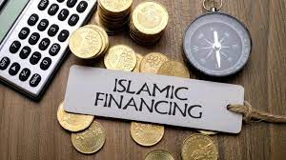
This Presentation Agenda
01
IB & F Current Global Trends
02
Transition from LIBOR
03
Inherent Challenge/Mistakes
04
Unique challenges
05
Taxation Issues to Be addressed
06
Conclusion

Slide 4
01: What is Happening?

Slide 5
Islamic Banking and Finance Global Trends
The Growth Trend is Good
Here Are the Trends
The industry's total worth, according to Refinitiv & ICD 2020 Report, across its three main sectors (banking, capital markets, and Takaful), is expected to be USD 3.69 trillion by 2024.
Global Islamic Finance assets
increased by 14 percent year-
on-year totaling USD
2.88 trillion in 2019.
Islamic Finance assets of Gulf
Cooperation Council (GCC)
reached USD 1.2 trillion in 2019,
followed by Middle East and North Africa (MENA) at USD
755 billion (excluding the
GCC), and Southeast Asia at
USD 685 billion
Diversity of Islamic Banking and Finance
The global Islamic banking and Finance market covers different aspects, like Islamic Banking, Sukuk, Takaful, Islamic Microfinance and Shari’ah Compliant Capital Markets

Slide 6
There are Sad Stories
IB & F Global Trends (Contd...)
Takaful Is Not Doing Well
Assets at 51 billion U.S. dollars with a total of 336 Takaful operators worldwide in 2019, Takaful isn’t doing fine as expected
However, looking forward, the global Takaful market is expected to grow at around 11% during the forecast period (2021-2026)
The Islamic banking sector contributes the bulk of the global Islamic Finance assets (71%). The sector grew 14 percent in 2019, equating to USD 1.99 trillion in global assets
Islamic Microfinance?
Sukuk Issuance is Growing
The Islamic finance industry has made great strides over the last 40 years. Currently valued at USD1.357 trillion
Many critics have argued that Islamic microfinance has yet to demonstrate it can provide financial services that meet the needs of the poor on a large scale
Corporate Sukuk issuance has also picked up after a cautious halt in the first quarter of 2020

Slide 7
2.0 Transitioning From Libor: Implications For IB&F
LIBOR: Announcement by Financial Conduct Authority (FCA) that London Interbank Offered Rate (LIBOR) will close by the end of 2021
Working groups established by UK, US and EU for each of the five
LIBOR currencies (USD, Pound Sterling, Japanese Yen, Swiss frank)
have since chosen replacement overnight Risk-Free Rates “RFRs”).
SONIA (the replacement rate for Sterling LIBOR) and SOFR (a
replacement rate for USD LIBOR) have been published since
April 2018
LIBOR is a “forward-looking” rate , the RFRs are overnight rates
(“backward looking”). RFR would be determined on the basis of
historical data at the end of each calculation period
This lack of visibility/clarity presents an issue in Islamic finance
transactions due to Shari’ah principle of No Gharar absolute
certainty on all fundamental terms in Islamic financing contracts

Slide 8
Why This?
3.0 The Key Inherent Challenges in IB & F
Uneven Playing field
However, much of the potential of the industry remains to be exploited. The empirical evidence
does not yet confirm that IB & F has indeed promoted enough financial access and depth once structural factors are accounted for (Barajas, Ben Naceur, and Massara 2015)
Lower economies of scale, and sometimes an uneven playing field between IB & F and conventional finance, play a role
Different Practices?
Large difference in practice across banks and limited standardization and securitization create additional
uncertainty for Islamic finance customers.(Audit reports)
IB & F Standardization
Although global Islamic regulatory bodies and standard setters have created principles and detailed technical standards, there is further scope for their implementation by national authorities and IFIs who are often more focused on global conventional banking standards
Governance Issues?
Scarcity of Shari’ah scholars with financial sector expertise,
and a slow pace of innovation are also weighing on the IB & F industry

Slide 9
3.0 The Key Inherent Challenges (Contd...)
The Impact........
Fig. 1 ; Key Inherent Issues
Regulation and Supervision
Islamic banks are subject to unique risks that pose challenges for their legal and regulatory frameworks
These challenges may not only be impeding development of IB & F, but could also encourage practices and products that are complex, thus carrying heightened risks to IB & F. What Risks?
01
02
03
Ensuring Shari’ah Compliance
Safety Nets and Resolution Frameworks
Regulators do not always have the capability (or willingness) to ensure that banks have in place a sound framework for Shari’ah compliance—nor do they take responsibility for assessing whether Shari’ah advisors are fit and proper
Although, in principle, conventional resolution tools can be applied to Islamic banks, frameworks that address the particular challenges posed by Islamic finance will need to be developed

Slide 10
3.0 The Key Inherent Challenges (Contd...)
Differences in Practices
Fig. 1B: Key Inherent Issues
Differences in practice among IB & F even in one jurisdiction poses a problem of consumers lack of confidence. Examples in Tanzania;-
Murabaha financing
Disclosure of bank reports
04
05
06
Sukuk and Its Securitization
Macroeconomic Policies
Sukuk can help close the funding gap for infrastructure, and an increasing share of issuance has been in this area- Short and long term liquidity needs of IB & F
Money and interbank markets for Shari’ah-compliant instruments have not yet developed in most countries, in part because of a lack of available instruments or lack of regulatory and legal frameworks for Islamic banks or both

Slide 11
4.0 Unique challenges for the implementation of Macroprudential
Policies to Islamic Banking and Finance
06
01
Differences in the notion of debt and equity between conventional and Islamic banking and finance
Limited availability of data and nonstandard disclosure practices
Cross-country differences in the supervisory and regulatory
approach to Islamic banks
05
The lack of standardization of Islamic products across jurisdictions and harmonization and coordination of prudential standards (e.g IFSB standards)
Option A?
02
Option B?
04
03
Different interpretations of and
practices for Shari'ah-compliant transactions across jurisdictions
The identification and monitoring of systemic risks. Example; capital, liquidity, credits, operational and ethical risks)

Slide 12
5.0 Taxation Issues to be Addressed
Taxation Issues
To level the playing field between conventional and
Islamic finance, a number of issues will need to be
addressed in the context of domestic and international
taxation
systems
Whereas some issues can
be easily addressed at the
national level, others may
require international
cooperation
These relate primarily to the treatment of Islamic
finance under income taxes, sales taxes (for example,
value added taxes on assets), specific transaction
taxes, and bilateral tax treaties as well as interest
Here comes the need for
internationalization of
issues facing Islamic
banking and Finance
This has limited the scope for money market trading
and the development of central bank liquidity
facilities for Islamic banking and finance, both of
which are necessary for market-based monetary policy
The presence of AAOIFI,
IFSB, ICD, IIRA, IsDB is a
positive step towards
sustainability of Islamic
Banking and Finance
(How many banks use AAOIFI
or IFSB standards?)
They may arise in the context of financial/ banking
regulations, Takaful regulations, intermediation,
portfolio investment, brokerage activities, insurance,
and so on

Slide 13
5.0 Taxation Issues to Address (Contd...)
Taxation Issues
Among these issues, those arising from differences in the
notion of debt and equity between Islamic and
conventional finance (and the tax treatment of related
returns) stand out
In practice, most modern
tax systems can deal with
this apparent disadvantage
by treating the economic
substance of Islamic
instruments similarly to
conventional instruments
Conventional tax systems (and in particular corporate
income taxes ) recognize the return to debt (but not
equity) as a deductible cost for income tax purposes
Experience shows that this
may or may not require
changes to countries’ tax
legislation
This has limited the scope for money market trading
and the development of centralized source of liquidity
facilities for IFIs, both of which are necessary for
market-based monetary policy
In this context, changes to
regulations or application
rules may be sufficient to
provide solution to tax
treatment of the main
Islamic finance instruments
This so-called debt bias banking industry, in principle,
a major disadvantage in Islamic finance since Shari’ah
does not recognize interest loans as being
permissible

Slide 14
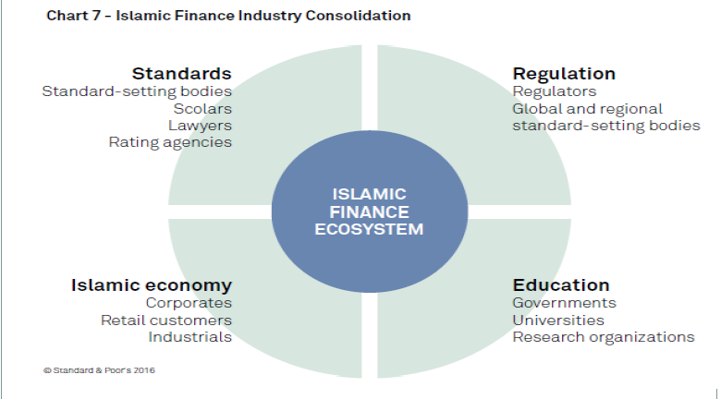
5.0 Taxation Issues to be Addressed
The Future
Regulatory framework
need to be in place
otherwise Islamic banking
and finance is lame
Use of international
standards ensures
uniformity and customer
trust
Continuous Awareness
through media and
education through
educational institution is
the future of Islamic
banking and finance

Slide 15
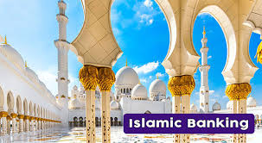
6.0 Conclusion
There are genuine challenges in Islamic
Banking and Finance BUT there mistakes
being done by banks offering IB & F
The major mistakes are disregarding
Shari’ah, Governance and Auditing
Standards issued by AAOIFI and IFSB and
relying on SSBs
Lack of regulatory and supervisory
framework is hampering the growth of IB
& F thus policy makers and other
stakeholders need to work hard to reverse
this trend

Slide 16
جزاكم الله خيرا

